Slide 1
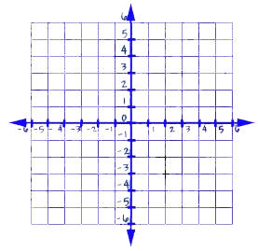
Notes
Warm-up:
Write a definition for each term in your own words:
Line
Equation
Slope
X-intercept

Slide 2
Notes

Slide 3
Notes

Slide 4
Notes

Slide 5
Notes

Slide 6
Notes

Slide 7
Notes

Slide 8
Notes

Slide 9
Notes

